Slide 1
Chapter 2.3
Trees
Make Money Fast!
Stock
Fraud
Ponzi
Scheme
Bank
Robbery

Slide 2
2.3 General Trees
Tree is one of the most important non-linear Data Structures in computing.
Tree structures allow us to implement a host of algorithms much faster than when using linear data structures, such as list.
Trees also provide a natural way to organize data in many areas such as:
  File systems
  Graphical User Interfaces (GUI)
  Databases
  Web Sites
  and many other computer systems.

Slide 3
Tree Structure
In computer science, a tree is an abstract data type that stores elements in a hierarchical structure.
A tree consists of nodes with a parent-child relationship, rather than the simple “before” and “after” relationship, found between objects in sequential (linear ) structures.
A famous example of hierarchical structure (tree) is the family tree.
Applications:
  Organization charts
  File systems
  Programming environments

Slide 4
Tree Definitions and Properties
A tree T, is an abstract data type that stores elements hierarchically.
Except the top element (root), each element in a tree has a parent and zero or more children elements.
root: node without parent (Node A)
Internal node: node with at least one child (A, B, C, F)
External node ( leaf ): node without children (E, I, J, K, G, H, D)
Sibling nodes: Two nodes that are children of the same parent are Siblings .
Depth of a node: number of its ancestors
Height of a tree: maximum depth of any node
Ancestors of a node: parent, grandparent, grand-grandparent, … etc.
Descendants of a node: child, grandchild, grand-grandchild, … etc.
Subtree: a tree consisting of a node and its descendants

Slide 5
Example
An example of a tree T:
T root is node A
Internal (branch) nodes are nodes A, B, C, F
External nodes (leaves) are nodes E, I, J, K, G, H, D
Depth of node F is 2
Height of T is 3
Ancestors of node H are C and A
Children of node A are B, C and D
Nodes B, C and D are siblings
Descendants of node B are E, F, I, J and K
A
B
C
D
E
F
G
H
subtree
I
J
K
Example of Tree

Slide 6
Formal Definition of a Tree
Formally, we define a tree T as a finite set of nodes storing elements such that the nodes have a parent-child relationship, that satisfies the following properties:
  If T is nonempty, it has a specially designated node, called the root of T, that has no parent.
  Each node v of T other than the root has a unique parent node w.
  Every node with parent w is a child of w.
  Note that a tree may be empty.

Slide 7
Recursive Definition of a Tree:
  A tree T is either empty, or has a finite set of one or more nodes such that:
  There is one specially designated node, called the root, and
  The remaining nodes, (excluding the root), are partitioned into m ≥ 0 disjoint sets T₁ , T₂ , …, T_{m}, and each of these is in turn a tree.
  The trees Ti (i = 1, 2, …, m) are called the sub-trees of the root.

Slide 8
Subtree of Tree T
The subtree of a tree T, rooted at node v is the tree consisting all the descendants of v in T (including v itself).
Edges and Paths in Trees:
  An edge of tree T is a pair of nodes (u,v), such that u is the parent of v, or vice versa.
  A path of T is a sequence of nodes such that any two consecutive nodes in the sequence form an edge.
  As an example of a path, (Figure 7.2), is the sequence A, B, F, K. where (A , B) or (B , A) is an edge.

Slide 9
Ordered Trees
It is a binary tree – each internal node has atmost two children.
Proper binary tree – each internal node has two children.
A tree is ordered if there is a linear ordering defined for the children of each node;
That’s, we can identify the children of a node as being the first, second, third, and so on.
Such an ordering is usually shown by arranging siblings left to right, according to their ordering.
Ordered trees typically indicate the linear order among siblings by listing them in the correct order.
A famous example of ordered trees is the family tree.

Slide 10
2.3.1 Tree ADT
The tree ADT stores elements at positions, which are defined relative to neighboring positions.
Positions in a tree are its nodes, and the neighboring positions satisfy the parent-child relationships that define a valid tree.
Tree nodes may store arbitrary objects.
A position object for a tree supports the method: element() : that returns the object stored at this position (or node).
The tree ADT supports four types of methods, as follows.

Slide 11
Methods of a Tree ADT
Accessor Methods
These methods return and accept positions, such as the following:
  root(): Return the position of the tree’s root; an error occurs if the tree is empty.
  parent(p): Return the position of the parent of p; an error occurs if p is the root.
  children(p): Return an iterable collection containing the children of node p.

Slide 12
Notice that:
If a tree T is ordered, then the iterable collection, children(p), stores the children of p in their linear order.
If p is an external node, then children(p) is empty.
Any method that takes a position as argument should generate an error condition if that position is invalid.

Slide 13
Methods of a Tree ADT (Cont.)
Generic methods
  size(): Return the number of nodes in the tree.
  isEmpty(): Test whether the tree has any nodes or not.
  Iterator(): Return an iterator of all the elements stored at nodes of the tree.
  positions(): Return an iterable collection of all the nodes of the tree.
  swapElements(v,w): swap the elements stored at nodes v and w.
  replaceElement(v,e): replace with e and return the element stored at node v.

Slide 14
Methods of a Tree ADT (Cont.)
Query methods
In addition to the above fundamental accessor methods, the tree ADT also supports the following Boolean query methods:
  isInternal(p): Test whether node p is an internal node
  isExternal(p): Test whether node p is an external node
  isRoot(p): Test whether node p is the root node
These methods make programming with tree easier and more readable, since we can use them in the conditions of if -statements and while -loops, rather than using a non-intuitive conditional.

Slide 15
Example
An arithmetic expression represented by a tree.
external nodes – variables/constants
Internal nodes – one of the operators + - x and /
Each node has a value.
external node – variable/constant
internal node – result of applying its operation on its child nodes.

Slide 16
2.3.2 Tree Traversal Algorithms
Depth and Height
The depth of a node v in tree T, is the number of ancestors of v, excluding v itself.
the depth of the root of T is 0.
Recursive definition of the depth of node v:
  If v is the root, then the depth of v is 0. (Base Case)
  Otherwise, the depth of v is one plus the depth of the parent of v.
  Algorithm depth(T,v) :
  if T.isRoot(v) then
  return 0
  else
  return 1 + depth(T,T.parent(v))

Slide 17
Analysis of depth algorithm:
  Running time of algorithm depth(T,v) is O(1 + d_{v}), where d_{v} denotes the depth of node v in the tree T, because the algorithm performs a constant-time recursive step for each ancestor of v.
  Worst case running time - O(n), where n is the total number of nodes of T, since a node of T may have depth n-1 in the worst case.

Slide 18
Height
The height of node v in a tree T is also defined recursively:
  If v is an external node, then the height of v is 0.
  Otherwise, the height of v is one plus the maximum height of a child of v.
  The height of a non-empty tree T is the height of the root of T.
Algorithm height(T,v)
if T.isExternal(v) then
return 0 // base case
else
h ← 0
for each w in T.children(v) do
h ← max(h,height(T,w))
return 1 + h

Slide 19
Performance Analysis of height Algorithm
  The algorithm is recursive.
  It is initially called on the root of T, and eventually called on for each node of T.
  To determine the runtime of height algorithm:
    Sum the amount of time spent at each node.
    Processing each node in children(v) takes O(c_{v}) time, where c_{v} is the number of children of node v.
    The loop has c_{v} iterations, and each iteration takes O(1) time, plus the time for the recursive call on a child of v.
    Thus, for each node v, height spends O(1+c_{v} ) time, and its runtime is O(∑_{v}(1+c_{v} )), which is O(n).

Slide 20
Proposition 7.5
Let T be a tree with n nodes, and let c_{v} be the number of children of a node v. Then, summing over all vertices in T, ∑_{v} c_{v} = n-1.
Justification:
Since each node of T, except the root, is a child of another unique node, and thus ∑_{v} c_{v} = n - 1.

Slide 21
2.3.2 Tree Traversal
a systematic way of accessing, or “visiting” all the nodes of T, such that each node is visited once.
The specific action associated with the “visit” of a node v depends on the application of this traversal, for example:
  Increment a counter,
  Update content of v,
  Perform some computation for v, … etc.
There are many types of tree traversals.

Slide 22
Preorder Traversal
Visit each node before recursively visiting its children and descendants, from left to right (ordered tree). Root is visited first.
Each node is visited only once.
It takes O(n) time, where n is the number of nodes in tree, assuming that visiting a node takes O(1). That’s, preorder traversal is a linear time algorithm.
The preorder traversal is useful to get a linear ordering of nodes of a tree.
Application: It is a natural way to print the structure of directories

Slide 23
Preorder Traversal
Algorithm preOrder(T,v)
visit(v)
for each child w of v in T do
  preOrder (T,w) //Recursion
1
Make Money Fast!
2
5
9
1. Motivations
2. Methods
References
6
7
8
3
4
1.1 Greed
1.2 Avidity
2.1 Stock
Fraud
2.2 Ponzi
Scheme
2.3 Bank
Robbery

Slide 24
Postorder Traversal
The postorder traversal can be viewed as the opposite of preorder traversal.
It recursively traverses the children of the root first, from left to right, after that, it visits the root node itself.
As with preorder, it gives a linear ordering of the nodes of an ordered tree.
The postorder traversal of a tree T with n nodes takes O(n) time, assuming that visiting each node takes O(1) time. That’s, postorder traversal is a linear time algorithm.
Application: compute disk space used by files in a directory and its subdirectories.

Slide 25
Postorder Traversal
Algorithm postOrder(T,v)
  for each child w of v in T do
  postOrder(T,w)
  visit(v)
In a postorder traversal, a node is visited after its descendants.
9
cs16/
8
3
7
homeworks/
programs/
todo.txt
1K
1
2
4
5
6
h1c.doc
3K
h1nc.doc
2K
DDR.java
10K
Stocks.java
25K
Robot.java
20K

Slide 26
Other Kinds of Traversals
Inorder Traversal, applied only for Binary trees, where the node is visited in-between its left child and its right child.
Constant-Depth traversal, where we visit all nodes at depth d, from left to right, before we visit the nodes at depth d+1.
Thus, numbering the nodes of a tree T as we visit them in this way, is called the level numbering of nodes of T.

Slide 27
2.3.3 Binary Trees
A Binary tree is an ordered tree with the following properties:
Every node has at most two children
Each child node is labeled as being either a left child or a right child.
A left child precedes a right child in the ordering of children of a node, (Children form an ordered pair).
A Binary tree is called proper if each node has either 0 or 2 children. (also, called full Binary tree)
A Binary tree that is not proper, is improper.

Slide 28
Binary Trees
Recursive definition:
a Binary tree is either:
  a tree consisting of a single node, or
  a tree whose root has an ordered pair of children, each of which is a Binary tree
Applications:
  arithmetic expressions
  decision processes
  searching
A
B
C
D
E
F
G
H
I

Slide 29
Arithmetic Expression Tree
Binary tree associated with an arithmetic expression
  internal nodes: contain operators (+, -, *, /, log, … etc.)
  external nodes: contain operands (variables or constants)
Example: arithmetic expression tree for the expression
(2 × (a - 1) + (3 × b))
+
×
×
2
−
3
b
a
1

Slide 30
Decision Tree
Binary tree associated with a decision process
  internal nodes: questions with yes/no answer
  external nodes: decisions
Example: dining decision
Want a fast meal?
Yes
No
How about coffee?
On expense account?
Yes
No
Yes
No
Starbucks
Spike’s
Al Forno
Café Paragon

Slide 31
2.3.3 Binary Tree ADT
The Binary Tree ADT extends the Tree ADT, i.e., it inherits all the methods of the Tree ADT,
Binary tree ADT supports the following additional accessor methods:
  leftChild(p): return the left child of p, an error condition occurs if p is an external node/no left child.
  rightChild(p): return the right child of p, an error condition occurs if p is an external node/no right child.
  boolean hasLeft(p): test whether p has a left child
  boolean hasRight(p): test whether p has a right child
  Sibling(p) : returns the siblings of p, but null if p is root

Slide 32
Properties of Proper Binary Trees
Notation
  n number of nodes
  e number of external nodes
  i number of internal nodes
  h height
  b number of branches (edges)
Properties
  e = i + 1
  n = 2e − 1
  h ≤ i
  h ≤ (n − 1)/2
  e ≤ 2^{h}
  h ≥ log₂ e
  h ≥ log₂ (n + 1) − 1

Slide 33
Maximum Number Of Nodes
Level 0 1 node
Level 1 2 nodes
Level 2 4 nodes
Level 3 8 nodes
Max. number of nodes = 1 + 2 + 4 + 8 + … + 2^{h}
n ≤ 2^{h+1} - 1

Slide 34
Full Binary Tree
A full Binary tree of a given height h has 2^{h+1} – 1 nodes.
Height 3 full Binary tree.

Slide 35
Justification of Proposition 7.10
e = i + 1
n = e + i = b + 1, where b = Number of branches of Tree
since b = 2*i, as two branches go out from each internal node i
n = e + i = 2*i +1 so, e = i + 1
n = 2e – 1
since n = e + i , e = i + 1, so, n = 2e -1
also n = 2i + 1
e ≤ 2^{h}
this is the maximum number of external nodes in a proper Binary Tree, this represents the leaf nodes in the last level h of the tree,
(where first level is 0, last level is h, number of levels is h+1)
e ≥ h + 1
this is the minimum number of external nodes in a proper B. Tree, where the root has one leaf node, and so each next level has a single leaf node also.

Slide 36
Justification of Proposition 7.10 (Cont.)
n ≥ 2h + 1
this is the minimum number of nodes in a proper B. Tree, it’s true by 2 & 4 above.
i ≥ h
this is the minimum number of internal nodes in a proper B. Tree.
It’s true from 1&4 above.
i ≤ 2^{h} - 1
This is the maximum number of internal nodes, and comes from 1&3
2h + 1 ≤ n ≤ 2^{h+1} -1
This comes by from 6&7 and also from 3&4.
log₂ (n+1) -1 ≤ h ≤ (n-1)/2
From 9 above, by taking the log₂ for both sides of inequalities.

Slide 37
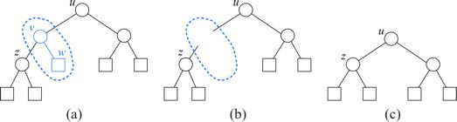
Internal Nodes & External Nodes in a Proper Binary Tree
e = i + 1
Case 1: If T has only one node v .
Case 2: Otherwise (T has more than one node).

Slide 38
2.3.4 Binary Tree representation
Linked Structure
Array List

Slide 39
Linked Structure for Trees
A node is represented by an object storing
  Element
  Parent node
  Sequence of children nodes
Node objects implement the Position ADT
∅
B
∅
∅
A
D
F
B
A
D
F
C
E
∅
∅
C
E

Slide 40
A Linked Structure for Binary Trees
A node is represented by an object storing
  Element
  Parent node
  Left child node
  Right child node
Node objects implement the Position ADT
∅
B
∅
∅
B
A
D
A
D
∅
∅
∅
∅
C
E
C
E

Slide 41
Performance of Linked Implementation of Binary Trees
Space Complexity: is O(n)
Time Complexity:
Operation | Time
size, isEmpty | O(1)
positions | O(n)
elements | O(n)
swapElements, replaceElement | O(1)
root, parent, children, left, right, sibling | O(1)
isInternal, isExternal, isRoot | O(1)
insertLeft, insertRight, attach, remove | O(1)

Slide 42
7.3.5 Array-List Representation of Binary Trees
Based on the way of level numbering the nodes of T.
Nodes are stored in an array
For each node v of T, let p(v) be an integer defined as follows:
  If node v is the root, then p(v) = 1
  if node v is the left child of node u, then p(v) = 2* p(u)
  if node v is the right child of node u, than p(v) = 2* p(u)+1
The function p is known as a level numbering of nodes of T.
This level numbering suggests an implementation of a Binary Tree, T, by means of an array list S such that node v of T is the element of S at index p(v). We realize array list S by means of an extendable array.

Slide 43
Example
The figure below is an example of a Binary tree and its level numbering.
Note that some numbers are skipped through numbering process, e.g., numbers 8 & 9.
1
+
2
3
×
×
4
5
6
7
2
−
3
b
10
11
a
1

Slide 44

Array Representation
1
a
2
3
b
c
4
5
6
7
d
e
f
g
8
9
10
11
h
i
j
k
tree[]
a
b
c
d
e
f
g
h
i
j
k
0
5
10

Slide 45
Array-List Representation of Binary Trees
1
nodes are stored in an array:
A
…
2
3
B
D
This is a simple and efficient implementation.
We can easily perform the methods root, parent,
left, right, hasLeft, hasRight, isInternal, isExternal,
and isRoot by using simple arithmetic operations
on the number p(v), associated with each node v
involved in the operation.
4
5
6
7
E
F
C
J
10
11
G
H

Slide 46
Performance of Array Implementation of Binary Trees
Space Complexity
Array list S is implemented by means of an extendable array.
Let n be number of nodes in T, and let p_{M} be the max. value of p(v) over all nodes of T.
Size of array list S is N = p_{M} + 1, since index 0 of S has no nodes stored in it.
In worst case, S has N = 2^{n} elements, exponential complexity.

Slide 47
Time Complexity
Operation | Time
size, isEmpty | O(1)
iterator, positions | O(n)
replace | O(1)
root, parent, children, left, right | O(1)
hasLeft, hasRight, isInternal, isExternal, isRoot | O(1)

Slide 48
Binary Tree Traversal
Preorder
Postorder
Inorder
Euler Tour

Slide 49
1. PreOrder Traversal
Algorithm binaryPreOrder(T,v)
  visit(v)
  if hasLeft (v) then
    binaryPreOrder (T,left (v))
  if hasRight (v)
    binaryPreOrder(T,right (v))
1
2
7
3
4
8
9
5
6

Slide 50
2. PostOrder Traversal
Algorithm binaryPostOrder(T,v)
  if hasLeft (v) then
    binaryPostOrder (T,left (v))
  if hasRight (v)
    binaryPostOrder(T,right (v))
    visit(v)
9
5
8
1
4
6
7
2
3

Slide 51
3. Inorder Traversal
Algorithm inOrder(T,v)
  if hasLeft (v) then
    inOrder (T,left (v))
  visit(v)
  if hasRight (v)
    inOrder (T,right (v))
In an inorder traversal a node is visited after its left subtree and before its right subtree
6
2
8
1
4
7
9
3
5

Slide 52
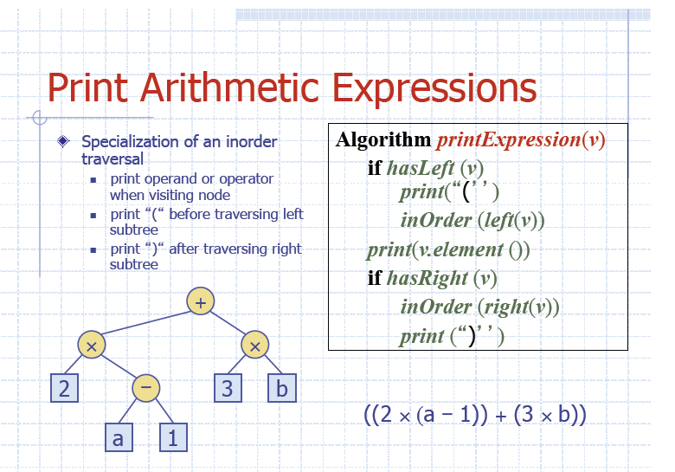

Slide 53
Expression tree
+
×
×
2
−
3
b
a
1
You can generate a formula of expression called postfix, prefix, infix expressions.
Inorder: 3 * 7 + 4 ^ 2 (infix form)
Preorder: + * 3 7 ^ 4 2 (prefix form)
Postorder: 3 7 * 4 2 ^ + (postfix form)

Slide 54
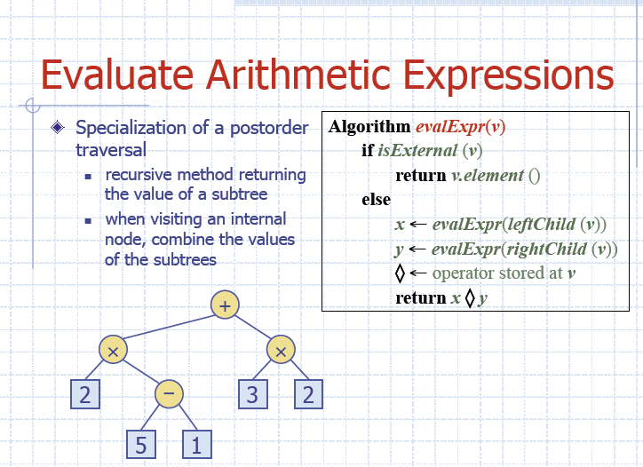

Slide 55
4. Level-order traversal
Visit the root, then visit all depth-1 nodes (left to right), then all depth -2 nodes, ... etc.
+ * * 2 - 3 b a 1
Implementation: not recursive.
Use a queue: which initially contains only the root.
Repeat, dequeue a node from the list,
visit it,
enqueue its children (left to right)
Until queue is empty
+
×
×
2
−
3
b
a
1

Slide 56
Euler Tour Traversal
edges in a tree are bi-directional.
the Euler tour is a path that begins at the root and ends at the root.
each edge is traversed exactly twice – once to enter the subtree and once to exit the subtree.

Slide 57
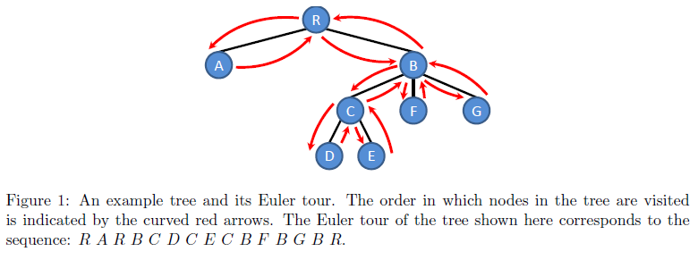
Example : An Euler tour

Slide 58
Euler Tour Traversal of a binary tree
Visiting the node more than one time.
Generic traversal of a binary tree
Walk around the tree and visit each node v of T three times:
  on the left (before the Euler tour of v’s left subtree)
  from below (between the Euler tours of v’s two subtrees)
  on the right (after the Euler tour of v’s right subtree)
+
L
×
R
×
B
2
−
3
2
5
1

Slide 59
Euler Tour Algorithm
Algorithm eulerTour(T,v)
visit(v) on the left
If hasLeft (v) then
eulerTour(T,left(T,v))
visit(v) from below
If hasRight (v) then
eulerTour(T,right(T,v))
visit(v) on the right
We can unify all three tree traversal algorithms given above into a single framework by relaxing the requirement that each node be visited once.
Applications:
  Calculate the No. of descendants of a node.
  Print a fully parenthesized arithmetic expression.

Slide 60
Print Arithmetic Expressions
((2 × (a − 1)) + (3 × b))
Algorithm printExpression(T,v)
if T.isExternal (v) then
print the value stored at v
else
print “(“
printExpression (T, T. leftChild(v))
print the operator stored at v
printExpression (T, T. rightChild(v))
print ")"
+
×
×
2
−
3
b
a
1
on the left : if node is internal, print “(“
from below : print the value/operator stored at the node
On the right : if the node is internal, print “)”

